Slide 1
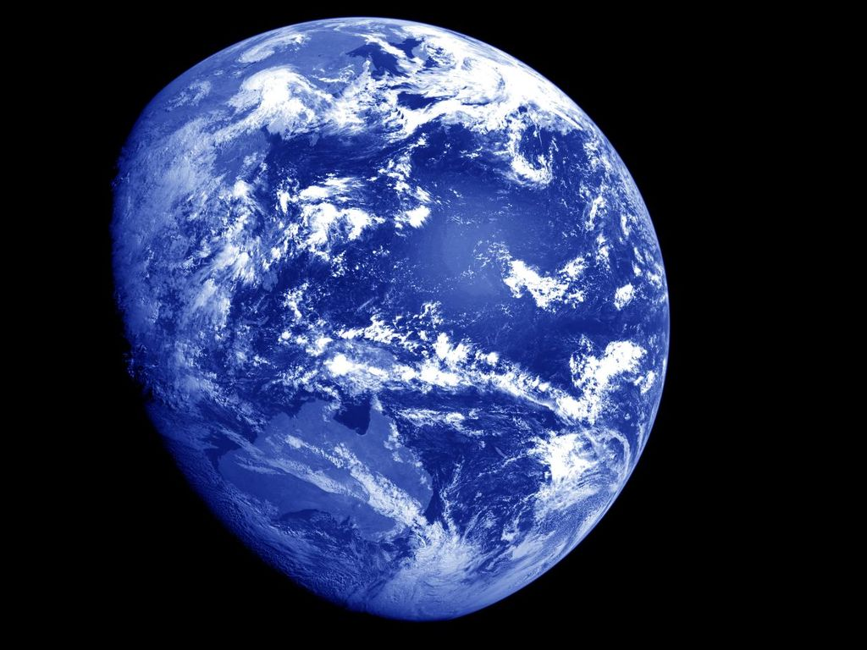
Intro to
Oceanography

Slide 2
What is Oceanography?
Study of the ocean, its surroundings, and life within it.
How does it differ from Marine Biology?
Marine bio studies marine organisms’ anatomy, physiology, behavior; more individualistic.

Slide 3
The five principal oceans
Pacific
Atlantic
Indian
Arctic
Southern or Antarctic Ocean

Slide 4
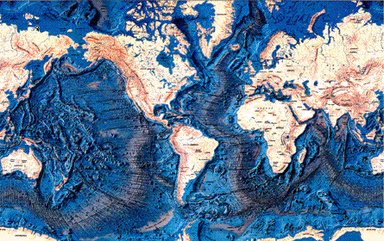
Earth's Oceans
Artic
Atlantic
Pacific
Indian
Southern or Antarctic
Notes:
The Earth's oceans are all connected to one another. Until the year 2000, there were four recognized oceans: the Pacific, Atlantic, Indian, and Arctic. In the Spring of 2000, the International Hydrographic Organization delimited a new ocean, the Southern Ocean (it surrounds Antarctica and extends to 60 degrees latitude).
The oceans of Earth are unique in our Solar System. No other planet in our Solar System has liquid water (although recent finds on Mars indicate that Mars may have had some liquid water in the recent past). Life on Earth originated in the seas, and the oceans continue to be home to an incredibly diverse web of life.
The oceans of Earth serve many functions, especially affecting the weather and temperature. They moderate the Earth's temperature by absorbing incoming solar radiation (stored as heat energy). The always-moving ocean currents distribute this heat energy around the globe. This heats the land and air during winter and cools it during summer.
OCEANS ARE DEFINED BY POSITION OF OCEAN BASINS & POSITION OF CONTINENTS
Pacific- world’s largest ; relative size- 50.1%
Atlantic- ½ the size of the Pacific ; relative size- 26%
Indian- slightly smaller than the Atlantic ; relative size- 20.5%
Arctic- ; relative size- 3.4%
Southern or Antarctic
7 SEAS: smaller and shallower and somewhat enclosed by land
North Pacific, South Pacific, North Atlantic, South Atlantic, Indian, Arctic, Southern or Antarctic

Slide 5
Comparison of Oceans Size
Ocean
Area (square miles)
Average Depth (ft)
Deepest depth (ft)
Pacific Ocean
64,186,000
15,215
Mariana Trench, 36,200 ft deep
Atlantic Ocean
33,420,000
12,881
Puerto Rico Trench, 28,231 ft deep
Indian Ocean
28,350,000
13,002
Java Trench, 25,344 ft deep
Southern Ocean
7,848,300
13,100 - 16,400
the southern end of the South Sandwich Trench, 23,736 ft (7,235 m) deep
Arctic Ocean
5,106,000
3,953
Eurasia Basin, 17,881 ft deep

Slide 6
Ocean
Disciplines

Slide 7
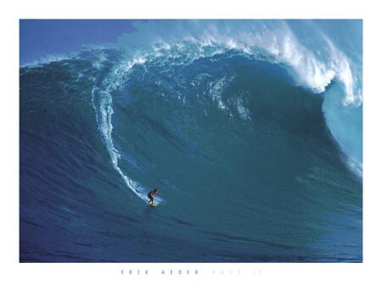
Physical Oceanography
How and why ocean currents flow, air-sea interactions such as the generation of waves by wind.

Slide 8
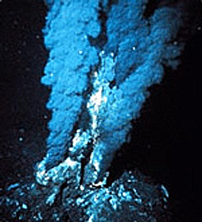
Chemical Oceanography
Composition of sea water and the processing controlling and altering its composition, including marine pollution

Slide 9
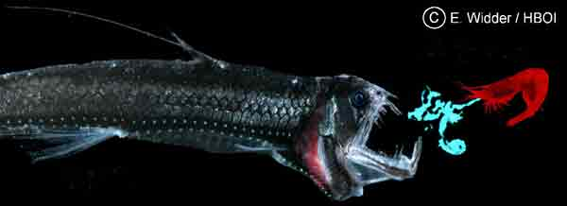
Biological Oceanography
Organisms that live in the ocean and their relationship to the environment

Slide 10
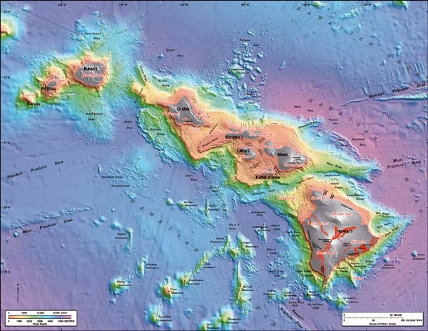
Geological Oceanography
Study of rock structure in the ocean basin, properties of rocks such as magnetism, occurrence of earthquakes.

Slide 11
That’s not all – hot topics cross disciplines
Biogeochemistry – nutrient & chemical transformations and cycles over time
Geophysics – seismology, paleomagnetics, plate tectonics
Biocomplexity – ecology in the face of chemical & physical constraints
Marine genomics & proteomics – census of marine life; diversity

Slide 12
WHY WE STUDY OCEANOGRAPHY

Slide 13
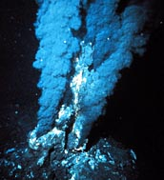
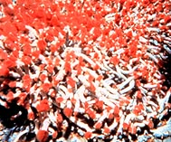
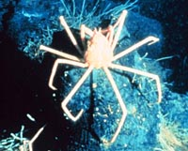
We study the ocean for the following reasons…
The ocean has a vast amount of living space that we know little about. What lives there and how do these organisms interact? How are they adapted to their environment?

Slide 14
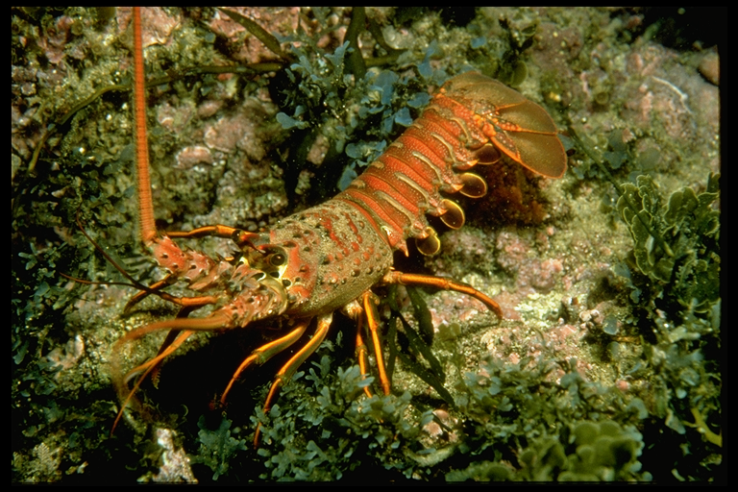
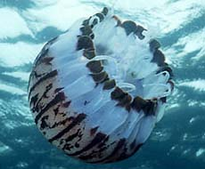
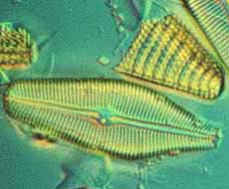
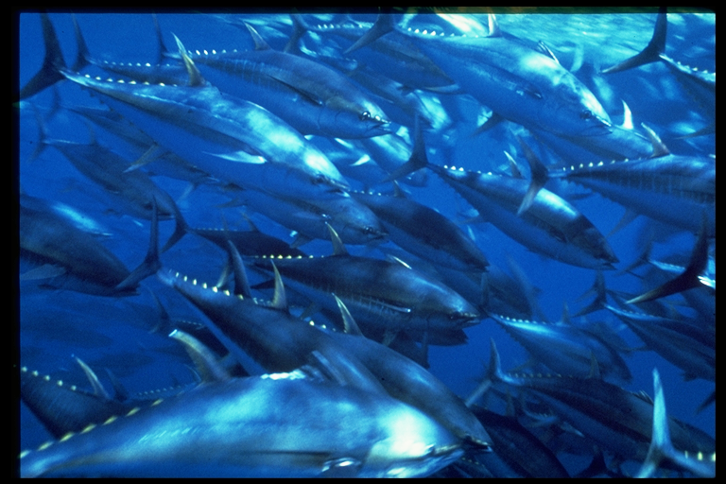

Slide 15
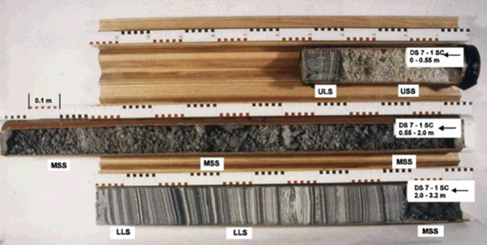
We also study the ocean for the following reasons…
The ocean’s influence on weather and climate.
(CO₂ (1/3 of all emissions) absorption, El Nino, hurricanes)
There are many minerals in the sea.
(Manganese nodules, oil drilling platforms, etc…)
Past climate research (paleoclimates) – Cores

Slide 16
We also study the ocean for the following reasons…
Human use of the ocean.
Fisheries, causes of fluctuations in resources, influence of commercial & sport fishing. Fin & shellfish etc…Aquaculture – Salmon, Mussels, etc…
Carrageenan from macroalgae: source of Food.
Drugs from marine organisms.

Slide 17
HISTORY

Slide 18
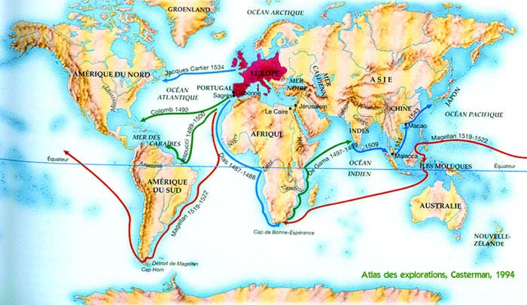
Voyage of Columbus (1492) and Magellan (1519)
Notes:
Voyage around the World.
On September 20th 1519 Magellan set sail from Sanlucar de Barrameda in southern Spain. He commanded a total of 241 men and a fleet of five ships ;the Concepcion, San Antonio, Santiago, Trindad and Victoria. About a month after the voyage began the Spanish captain of the San Antonio challenged Magellan’s authority and Magellan had him arrested.
The fleet sailed across the Atlantic Ocean to the coast of Brazil. The ships followed the coast to the bay where Rio de Janeiro now stands. They remained there for two weeks and then sailed South in search of a passage to the Pacific Ocean. However they could not find a passage before the end of summer in the Southern Hemisphere. In late March 1520 the fleet anchored for the winter at San Julian in what is now southern Argentina. During the winter a storm destroyed the Santiago. In addition a mutiny broke out shortly after the men set up their winter quarters. Magellan and loyal crew members put down the mutiny and executed the leader. They also marooned two other mutineers when the fleet sailed again.
Magellan and his crew resumed their voyage on October the 18th 1520. Three days later they discovered the passage to the Pacific -- a passage known every since as the Strait of Magellan. As the fleet sailed through the strait, the crew of the San Antonio mutinied and returned to Spain. On November 28th, the three remaining ships sailed out of the strait and into the ocean.
Magellan named the Ocean the Pacific, which means peaceful, because it appeared calm compared with the stormy Atlantic.
Sailing across the Pacific.
They were the first Europeans ever to sail across the Pacific and it was far larger than anyone had imagined. They sailed for ninety - eight days without seeing any land except two uninhabited islands. There food became contaminated and nineteen men died before the fleet reached Guam on March the 6th, 1521. After a while the crew seized enough food and water to continue the journey to the Philippines. On April 27th Magellan was killed when he took part in a battle between rival Filipino groups on the island of Mactan.
One of the crew members who returned with Del Cano was an Italian named Antonio Pigafetta. He had written down the events of the voyage, and his journey is the source of information about the expedition. According to Pigafetta, the voyage covered 50,610 miles. Magellan who was looking for the Spice Islands failed to find a short route to them, but his voyage contributed greatly to knowledge about the earth. In addition the discovery of the Strait of Magellan lead to future European voyages to explore the vast Pacific.
Magellan's Voyage
The crew of Portuguese sea captain Ferdinand Magellan were the first Europeans to sail around the world, proving that the world was round. From 1519 to 1521, Magellan, with 5 ships and a Spanish crew of 241 men, searched for a western route to the Spice Islands. He was killed in a battle with Philippine natives on April 27, 1521, and only two of his ships continued to the Spice Islands. The two ships then made separate return voyages, and only one, commanded by Juan Sebastian delCa completed the trip back to Spain.
Passing Through the Straits
When a small boat was dispatched from the mutineer’s ships to give Magellan their demands, Magellan cleverly positioned his vessel between the small boat and the mutinous ships. The mutineer commanders could not see that Magellan arrested the party and put men loyal to him in the boat to take back his message. When they arrived at one of the mutineer ships, one of the men—acting under Magellan’s orders—immediately stabbed and killed the leader of the mutiny on that vessel. At the same time, men loyal to Magellan clambered on board the other rebellious ships. The bold move worked, as the mutineers, with their leader dead, did not resist.
Consequently, in that era’s horrific mode of naval punishment, Magellan had the remaining captains of the mutiny executed in front of the assembled crew. Magellan sentenced to death the men who had gone along with the mutiny. Then, in a stroke of brilliant psychology, after letting them despair for some time, Magellan announced that they were pardoned. As a result, the grateful men forged unswerving loyalty to their commander. They would need it, for Magellan would lead them through terrible ordeals.
After more than a year from the date of their departure, in October of 1520, Magellan found a strait, now bearing his name, which would allow them through the frigid waters at the tip of South America. Leaving one hapless mutineer behind in Patagonia (Southern Argentina), he continued the journey. It took 38 days to negotiate the narrow strait and during that time one of the ships deserted and turned back for Spain. Magellan was never to know what happened to it. When the deserting ship reached Spain, the officers and crew began to spread lies about Magellan.
Balboa had seen the ocean earlier and named it the great Southern Sea. It was Magellan who called it the Pacific (peaceful) due to the gentle winds that he found as he entered. Today the water passage between the two great oceans (the Atlantic and Pacific) is named the Strait of Magellan in the explorer’s honor.
Magellan resisted the pleas of the timorous, who wanted to turn back for Spain, and continued across the vast emptiness of the Pacific. It was to be one of the most difficult voyages in the history of navigation. After two months of sailing they were nowhere near any major land mass. During the bleak Pacific crossing, Magellan’s men ate the last of their biscuits, now rotten or reduced to insect-infested powder. When the biscuits were gone they ate sawdust, the leather from their belts and shoes (boiled until softened) and any rats they could catch. The going price for a rat was half a crown, a small gold coin. Even when drinking the putrid water from the barrels on board, the men held their nose due to the brackish stench. Fortunately, occasionally flying fish would leap on board, and the men would pounce on this source of fresh seafood.
Not surprisingly the men developed scurvy. The sailor’s gums bled and turned black; “their gums grew fat,” wrote Pigafetta. They became feverish and docile, unable to work or even move. Dozens of them died. They were given last rites and were thrown overboard. About thirty more were so ill from scurvy that they could not work and in many cases could not move. The men despaired of surviving the voyage.
According to Magellan’s maps, he should have been in Asia. Little did he know he was not even half way across the vast Pacific. He threw the maps overboard in disgust. The very next day they spotted an island and landed briefly, but found little in the way of supplies. The crew decimated; they finally reached an island with bananas, coconuts, sugar cane and yams. The waters were teeming with fish. Magellan’s crew had sailed half way across the Pacific Ocean, the largest body of water on the planet.
By February 13th they had crossed the equator, and in March they landed in Guam. He called the island Ladrones (thieves) when the islanders tried to rob his boats. Today they are called the Marianas. On March 16th he landed on an island in what was to become known as the Philippines. They reached the Ladrone Islands and two weeks later the Philippines. They had sailed half way around the world. On one of the Philippine Islands, Magellan was given a basket of ginger and a bar of solid gold. He realized that the wealth of the Spice Islands must be near at hand.
Magellan continued westward and reached the island of Cebu, which he claimed for Spain. The commander must have been relieved and deeply satisfied. He had sailed half way round the world and had proven that the great water ways and oceans of the world were interconnected. He had demonstrated that it was possible to arrive in the east by sailing west. And now he had opened up a fabulous trade route for Spain. But here the story turns tragic for Magellan.
The people of Cebu and their ruler were peaceful and amicable at first, even when Magellan claimed the island for his king. When he tried to convert the chieftain to Christianity, the island leader seemed agreeable. Magellan did not realize that his seeming acceptance of the intentions of the Spaniard was superficial and insincere. It was customary among the island people to show politeness, grace and hospitality, but they would only bend so far.
The chieftain of Cebu had designs of his own; he thought to use the Spaniard’s presence to his advantage against a traditional enemy. He told Magellan that the nearby island of Cilapulapu was resisting Spanish authority by refusing to acknowledge the dominion of the Spanish crown. Magellan accompanied a large group of soldiers to the island where they made the mistake of attacking the main village. They were immediately confronted by a much larger band of armed islanders. The two groups exchanged volleys of arrows and spears for some time, but eventually Magellan decided to break off the attack. As his men retreat to the boats, Magellan was struck in the face by a spear. He fell to the ground and before his men could attempt a rescue, a swarm of islanders fell upon him and hacked him to death. Magellan’s men were disconsolate at the loss of their leader. They sailed back to Cebu and told the rest of the crew of the disaster. With the death of Magellan, the crew fell into squabbling and behaved like pirates among the natives. Finally a leader emerged who was able to organize them sufficiently to continue their voyage. He was Juan Sebastian del Cano.
Two of the remaining vessels developed leaks and became too dangerous to face the long voyage home, so they were destroyed. Now with only 47 Europeans and some islanders gathered on the way, the newly elected captain, Juan Sebastian del Cano, embarked for Africa. Their troubles were still not over. More men died of scurvy in the Cape Verde islands controlled by Portugal; others were arrested. Only eighteen of the original crew reached Seville at the end of three epic and tortuous years.
When the emaciated sailors disembarked, del Cano led them on foot to two churches where they gave thanks for their successful arrival. Stunned crowds gathered to stare at the stricken sailors who had endured indescribable privation and suffering. In recognition of his service, the king gave del Cano a small pension and a coat of arms with an image of a globe and the inscription. “You were the first to circumnavigate me.” The cargo of 26 tons of cloves which the crew had secured was sold at a tremendous rate of profit. Yet with such staggering losses and expenses for the voyage, the entire expedition barely paid for itself.
Magellan was almost forgotten and did not receive the honor due him until many years later. It is generally agreed by scholars of the voyage that had Magellan survived, many of the difficulties of the latter part of the voyage most likely would have been avoided. Sadly, his wife died when she heard the news of his death.
His voyage is one of the great accomplishments in all of world history. It has been said that up until Magellan’s circumnavigation of the earth, the world was constantly expanding. Since that time it has been growing smaller. Two decades after his death, a chronicler wrote the following tribute to the great navigator: “The track the Victoria followed is the most wonderful thing and the greatest novelty that has ever been seen from the time God created the first man and ordered the world unto our own day. Neither has anything more notable ever been heard or described since the voyage of the patriarch Noah.”
With the passage of time it is clear that Magellan was one of the ablest of the maritime leaders of the period. He combined leadership with diplomacy uncommon among the Spanish and Portuguese captains of conquest. Had he not tragically been killed, it is likely that many more of the original crew would have retuned home alive.

Slide 19
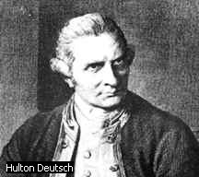
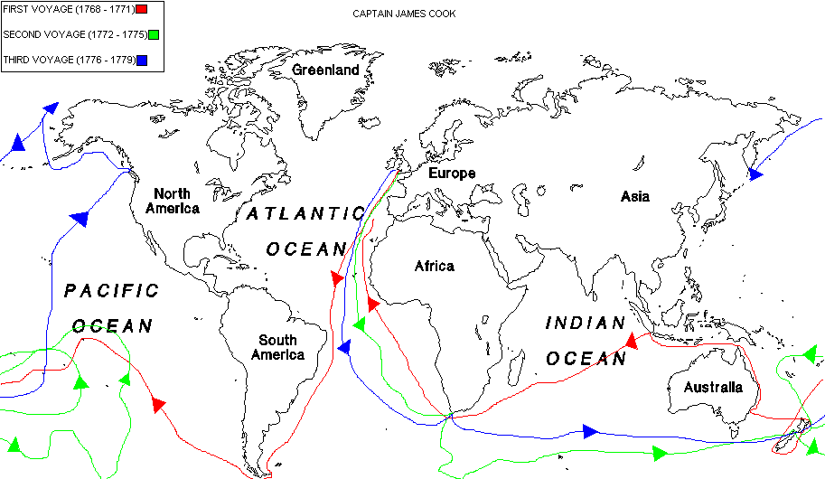
Cook (1700’s)- sailed twice around the world
1st European to visit Hawaii
Cook
Notes:
James Cook was born on October 27, 1728, in Marton-in-Cleveland, Yorkshire, England. He was the son of a farmer of Scottish decent. As a young teenager, Cook was apprenticed to a seafaring family. In 1755, he joined Great Britain's Royal Navy and soon proved himself an expert navigator. Just after making officer rank, Lieutenant Cook was chosen by the Royal Society of London to undertake a scientific journey to Tahiti to observe and document the planet Venus as it passed between the earth and the sun. These observations would help scientists calculate the distance of the earth from the sun. On August 25, [1768], Cook departed England aboard the Endeavour with 94 crewmen and scientists. He was carrying secret orders from the Royal Navy to be opened upon completion of his scientific mission.
Cook was determined to keep his crew healthy. He insisted his men eat onions and pickled cabbage every day, and made sure that the ship kept fresh fruit and vegetables on board. He ordered his men to bathe every day, to clean their clothing, and to air out their bedding. He did not know the scientific reasons behind these measures, but he knew they worked to prevent scurvy and other diseases in his crew.
On April 11, 1769, the Endeavour arrived on the shores of Tahiti, seven weeks early. After viewing the passing of Venus between the earth and sun for several weeks, Cook opened a sealed envelope with the Royal Navy's orders. He was to seek out the fabled southern continent and claim it for England. Early mapmakers in the 1570s assumed there were two major continents at each of the earth's poles. Dutch explorers searched for the southern continent in the seventeenth century. Since the continents had not yet been found, the Royal Navy trusted that Cook would find the southern one if it existed. He left Tahiti on July 13 and headed southwest.
When Cook reached New Zealand on October 6, the native Maori people proved to be unfriendly and his crew was forced to fire on them. The Endeavour spent a few months exploring New Zealand and proved it was not part of the great southern continent. On April 9, [1770], Cook explored and documented the location of Australia. While sailing around this great continent, the Endeavour ran aground on the Great Barrier Reef (extending 150 miles from Australia's northeast coast and the largest reef in the world) on June 11. It took a day to free the ship after the crew threw fifty tons of ship's ballast, iron cannons, firewood, and barrels overboard. Once free, the crew quickly made repairs to the badly leaking ship to keep it from sinking. After months of exploring the coastline of Australia, Cook concluded that this continent was not the great southern continent.
The Endeavour made its way to Java in the East Indies in October, 1770. Once there, Cook's men became very ill with Malaria and dysentery. Despite all his efforts to keep his crew safe and healthy, they were no match for these diseases. He lost 30 men and had to sign on new crew in South Africa in order to make it back home to England. The Endeavour made it back to Dover, England, on July 13, 1771, after a three-year voyage. Cook was formally presented to his majesty, King George III following the historic journey and made a naval commander

Slide 20
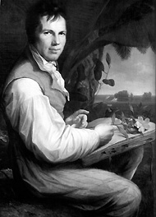
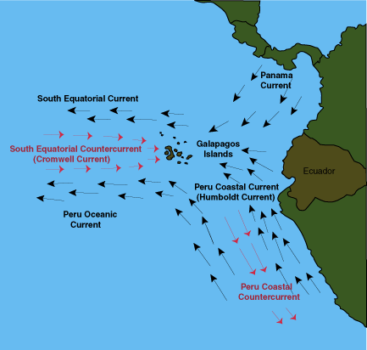
Humboldt (1800’s)- German naturalist, contributions in geophysics, meteorology, and oceanography
Notes:
Alexander von Humboldt was an ecologist before the word existed.
In 1799 the explorer left his native Berlin to embark on a five-year wilderness trek through Central and South America, where he gathered plant and animal specimens, recorded meteorological data, and developed ideas that would influence generations of scientists, including Charles Darwin.

Slide 21
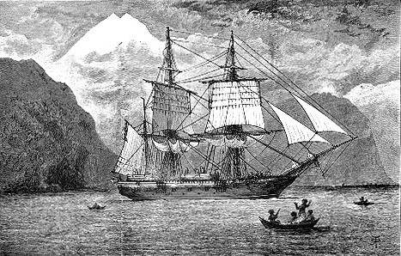
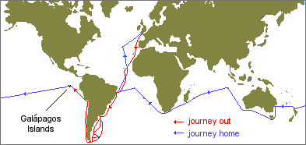
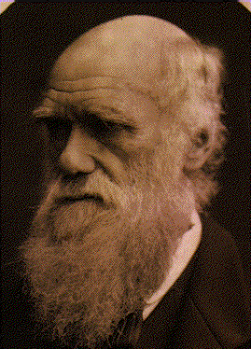
Voyage of the HMS Beagle
Darwin (1831):
Subsidence theory of coral reef formation (atolls) & origin of species
Notes:
The primary mission of the Beagle was to map the coastline of southern South America and take oceanographic measurements (currents, bathymetry, etc) as well. Darwin's job as ship's naturalist was to observe everything, write it all down and collect as many specimens as possible. It was his job to record the weather, geological features, plants, animals, fossils, rocks, minerals, indigenous people and anything else that he saw. Specimens had to be packed and labeled very carefully. In preparing for the voyage, Darwin made a list of things that he would need, including 12 new shirts and other clothing; slippers; light walking shoes; a folding, portable dissecting microscope; a geological compass; a case of pistols and a rifle; a Spanish-English dictionary; a book on taxidermy; reading material (Humboldt and Milton); his favorite geology text, Lyell's Principles of Geology; a Bible; a pair of binoculars; a magnifying glass; and jars of "Spirit" (probably alcohol) for preserving specimens. (I wonder what his dad thought of that list...Thanks, Dad!)
Like any expedition, there were space limitations. The Beagle was not an exceptionally large vessel by any means. Measuring only ninety feet in length, she carried a crew of 74 people, "including the Captain, three officers, the crew, a doctor, an artist, and the naturalist. Darwin shared the poop cabin (at the back of the ship) with two officers. Their space was so cramped that Darwin had to remove a drawer each night so that he would have room for his feet."
David Likely tells the story of how the ship's Captain Robert Fitzroy almost refused to let Darwin sail because his nose did not appear to be that of a man with character. Darwin had to get testimonials that he was suitable for dining at the Captain's dinner table. Apparently, Darwin and the Captain, a fundamentalist Christian, didn't always see eye to eye (Darwin was once banned from the dinner table for several days), which has led some to speculate that this relationship even further hardened Darwin against religion.
After more than two months delay (the ship was to leave October 24, 1831), the ship attempted a departure on December 10 but ran into bad weather. Finally, on December 27 at 2:00 pm, Darwin and the Beagle left Plymouth harbor on what was to become most revolutionary oceanographic expedition of our time.
Immediately upon sailing, Darwin's enthusiasm for the voyage was severely dampened by sea-sickness. He writes:
"...the misery I endured from sea sickness is far beyond what I ever guessed at. The real misery only begins when you are so exhausted that a little exertion makes a feeling faintness come on -- I found that nothing but lying in my hammock did any good.
Three and a half weeks later, on January 16 1832, they reached the Cape Verde Islands off the coast of south Africa. It was here that Darwin's innate ability to observe in great detail and think "large" began to assert itself. In St. Jago, he correctly surmised the African origins of dust that created the hazy atmosphere of the islands, he wrote about "reckless destruction" of the forests and offered the following observations on octopus:
I was much interested by watching the habits of an Octopus, or cuttle-fish. By means of their long arms and suckers, they could drag their bodies into very narrow crevices; and, when thus fixed, it required great force to remove them. These animals escape detection by a very extraordinary, chameleon-like power of changing their color. They appear to vary their tints according to the nature of the ground over which they pass. These changes were affected in such a manner that clouds, varying in tint were continually passing over the body. Any part, being subjected to a slight shock, became almost black.
While not the first to observe cephalopod chromatophores, the detail with which he describes them belies his fascination with nature. Indeed, the enthusiasm with which he carried out his observations and collections can be found in his diary entries upon exploring South America:
I have been wandering by myself in the Brazilian forest: amongst the multitude it is hard to say what set of objects is most striking; the general luxuriance of the vegetation bears the victory, the elegance of the grasses, the novelty of the parasitical plants, the beauty of the flowers, the glossy green of the foliage, all tend to this end...To a person fond of Natural History such a day brings with it pleasure more acute than he ever may again experience" [Barlow 1933: 39-40]. And the next day, "I can only add rapture s to the former raptures" [Barlow 1933: 40].[Journal of Syms Covington, Darwin's assistant]
Overtaken with such "treasures", Darwin felt that he needed an assistant. He got permission to hire Syms Covington, the ship's "fiddler and boy to the poop cabin" [where the officers lived], who helped with the time-consuming task of cataloguing and shipping Darwin's specimens. Covington kept his own journal [Journal of Syms Covington] which offers interesting reading about Darwin and his relationship with others on board.

Slide 22

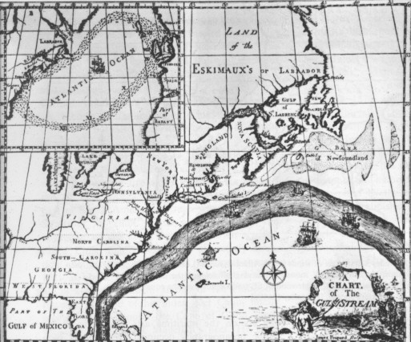
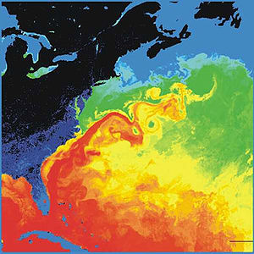
Ben Franklin (1770’s)- mapped the Gulf Stream
Surface temperatures in the western North Atlantic. The North American landmass is black and dark blue (cold), while the Gulf Stream is red (warm). Source: NASA
1786

Slide 23
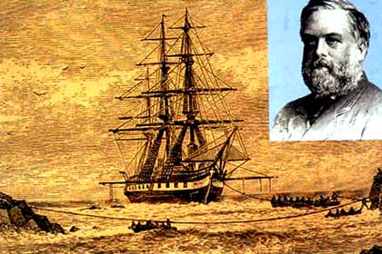
Voyage of the HMS Challenger (1872-1876)
collected thousands of biological and sea bottom samples
traveled in every ocean except arctic
cruise directed by Charles Wyville Thompson
362 stations, 715 new genera, 5000 new species
discovered Mariana Trench and Mindarniad (34,000 ft deep)
Notes:
On 21 December 1872 the 2306 ton steam assisted corvette HMS Challenger sailed from Portsmouth on a 3-year voyage of marine exploration which laid the foundations of almost every branch of oceanography as we know it today.
Her naval complement was headed by Captain G S Nares, an experienced survey officer, while the Director of her scientific staff was Charles Wyville Thomson, Professor of Natural History at the University of Edinburgh. These two men were responsible for an extremely wide-ranging programme of research into the physical and biological characteristics of the deep sea, for when the Challenger sailed the scientific investigation of the open oceans had hardly begun and many basic questions were still unanswered. What was the nature of the animal life in the very greatest depths? Indeed, did animals exist at all over wide areas of the sea bed? (Only a few years previously it had been widely assumed that life was untenable in the perpetual darkness, enormous pressures and intense cold of the abyssal depths.) What was the shape of the bottom of the great ocean basins, the composition of the bottom sediments and their source? And what of the sea water itself? Would a knowledge of its temperature variation with depth as well as its specific gravity give clues to the nature and causes of the complex system of sub-surface currents of which scientists were becoming aware?
To enable her to probe into these and many other problems, Challengers guns had been removed, her spars reduced, and laboratories, extra cabins and a special dredging platform installed. She was loaded with thousands of specimen jars, alcohol for preservation, microscopes and chemical apparatus, trawls and dredges, thermometers and water sampling bottles, sounding leads and devices to collect sediment from the deep sea bed and great lengths of rope with which to suspend the equipment into the ocean depths. In all she was supplied with the staggering total of 181 miles of best Italian hemp for sounding, trawling and dredging.
During the 68890 mile voyage the naval staff was responsible for taking a wide variety of magnetic and meteorological observations, and for the actual working of the sampling gears at the 354 official stations where the vessel stopped to make detailed studies. The work of the scientists, or 'philosophers' as they were nicknamed aboard, began with the arrival of the samples on deck. The water samples were examined by the chemist, John Young Buchanan, while the contents of the nets and dredges were the responsibility of Wyville Thomson and his three young naturalist assistants. All of the naturalists were involved in the documentation of the thousands of samples and their preparation for dispatch back home, but they also had their own particular research interests. H N Moseley, for instance, took particular interest in the corals and sea squirts, the young German, Rudolf von Willemoes Suhm, was mainly concerned with the crustaceans, while John Murray dealt with the pelagic organisms and the ocean deposits. The final member of the civilian staff, the Swiss J. J. Wild, acted as secretary to Wyville Thomson and artist to the expedition.
The voyage was an orderly and unhurried affair, with the ship proceeding mainly under sail at the somewhat matronly rate of about 100 miles a day, generally using her engine only to maintain position when she stopped to work a station every two or three days. For the period, the expedition was also a very healthy one, for only 10 fatalities occurred amongst the total complement of 243 during the whole voyage. One of these was Willemoes Suhm's tragic death from erysipelas while the ship was in the Pacific.
But they lost a further 61 ratings through desertion, evidently caused in part by a desire for a cheap passage to Australia as well as by the arduous and tedious routine of the sounding and dredging operations which often took many hours. The ratings were not the only ones affected, for many of the officers became discontented with their lot long before the voyage was over, and even amongst the scientists only Wyville Thomson seems to have retained his enthusiasm to the end.
Yet the expedition was not all tedium, for of the 1281 days spent away from home, 568 were spent in harbours in all quarters of the world. During these shore breaks the officers and scientists made extensive zoological, geological and ethnological collections and socialised with all manner of 'locals' ranging from the King of Portugal to recently cannibalistic Fijian natives!
By the time the ship returned to Spithead in May 1876, the expedition had already provided answers to some of the significant oceanographic questions which had been posed at the outset. There was now a much clearer idea of the form of the great ocean basins down to the greatest depth sounded at 4475 fathoms, including the important discovery of a submarine ridge running the length of the Atlantic Ocean. The varying types of sea-bed samples had been classified and it had been conclusively demonstrated that the deep-sea oozes were made up of the skeletons of tiny organisms which lived in the upper layers of the sea rather than on the bottom, a subject which had caused considerable controversy during the decade before the Challenger sailed. Ample evidence had been obtained of the existence of a rich and varied fauna in the very deepest regions, although there was no evidence that the ocean depths were occupied by 'living fossils' as some biologists had expected.
These results were apparent from the relatively cursory investigations which had been carried out on board, but the detailed examination of the massive collections of animals and plants, water and sea-bed samples, and of the vast quantities of numerical data had still to be accomplished. The mammoth task of organising the distribution of the material to the scientists who were to work on it and the publication of the results initially fell to Wyville Thomson. This involved him in a series of acrimonious exchanges with many individuals and institutions, including the Trustees of the British Museum who demanded that the specimens should go directly to the national collection instead of being separately distributed from an office in Edinburgh as Wyville Thomson wished. With the aid of the Royal Society Thomson eventually won this tussle, but the strain of the responsibility of establishing a style for the publication of the official reports with opposition from those who did not understand the requirements for accurate scientific investigations and illustrations, as well as the rigid accountability forced upon him, proved too much for his highly strung but unmethodical nature. He broke down first in 1879, and in 1881 when the initial five year grant from the Treasury came to an end he collapsed, resigned his professorship, and took to his bed to die in 1881. The reins were taken up by John Murray under whose forceful leadership the publication of the results was finally completed in 1895, almost a quarter of a century after the ship set sail. The fifty thick royal quarto tomes of the report, containing 29552 pages, were written by an international galaxy of scientists and many of these reports still form a starting point for specialist studies in oceanography. Similarly, many of the original samples on which the reports were based, including nearly 4000 new species of animals taken by the trawls and dredges, are still referred to by scientists from a11 over the world.
The reports were the tangible evidence of the achievements of the Challenger venture, but perhaps of much greater importance in the long term was the co-operation between scientists of many countries, inspired by Wyville Thomson's leadership, which set the young science of oceanography on the path to becoming the truly international discipline that it is today.
Postscript HMS Challenger's foray into oceanography interrupted an otherwise unremarkable career. In 1862 she had taken part in operations against Mexico, including the occupation of Vera Cruz, but otherwise the only action which she saw seems to have been a punitive operation in 1866 against some Fijian natives to avenge the murder of a missionary and some of his dependents. After her three years of glory, her fate was even more ignominious. Commissioned as a Coast Guard and Dril1 ship of Naval Reserves at Harwich in July 1876, she was finally paid off at Chatham in 1878. She remained in reserve until 1883, when she was converted into a receiving hulk in the River Medway, where she stayed until she was finally broken up for her copper bottom in 1921. Despite the great excitement which surrounded her middle years, virtually nothing, apart from her figurehead, now remains. This is on display in the foyer of Southampton Oceanography Centre.

Slide 24
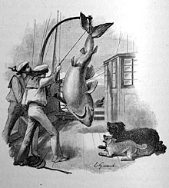
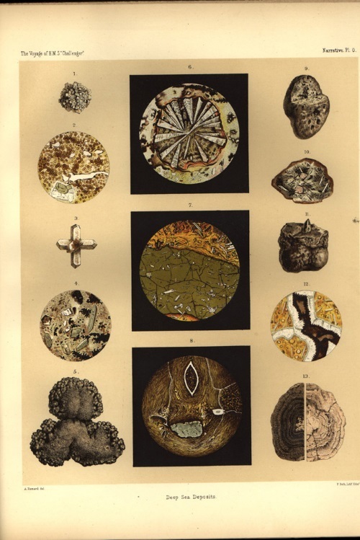
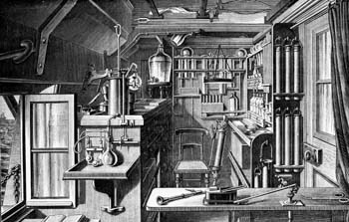
Voyage of the HMS Challenger (1872-1876)
Deep sea Collections
HMS Challenger's Chemical Laboratory
Notes:
During the 68890 mile voyage the naval staff was responsible for taking a wide variety of magnetic and meteorological observations, and for the actual working of the sampling gears at the 354 official stations where the vessel stopped to make detailed studies. The work of the scientists, or 'philosophers' as they were nicknamed aboard, began with the arrival of the samples on deck. The water samples were examined by the chemist, John Young Buchanan, while the contents of the nets and dredges were the responsibility of Wyville Thomson and his three young naturalist assistants. All of the naturalists were involved in the documentation of the thousands of samples and their preparation for dispatch back home, but they also had their own particular research interests. H N Moseley, for instance, took particular interest in the corals and sea squirts, the young German, Rudolf von Willemoes Suhm, was mainly concerned with the crustaceans, while John Murray dealt with the pelagic organisms and the ocean deposits. The final member of the civilian staff, the Swiss J. J. Wild, acted as secretary to Wyville Thomson and artist to the expedition.
The voyage was an orderly and unhurried affair, with the ship proceeding mainly under sail at the somewhat matronly rate of about 100 miles a day, generally using her engine only to maintain position when she stopped to work a station every two or three days. For the period, the expedition was also a very healthy one, for only 10 fatalities occurred amongst the total complement of 243 during the whole voyage. One of these was Willemoes Suhm's tragic death from erysipelas while the ship was in the Pacific.
But they lost a further 61 ratings through desertion, evidently caused in part by a desire for a cheap passage to Australia as well as by the arduous and tedious routine of the sounding and dredging operations which often took many hours. The ratings were not the only ones affected, for many of the officers became discontented with their lot long before the voyage was over, and even amongst the scientists only Wyville Thomson seems to have retained his enthusiasm to the end.
Yet the expedition was not all tedium, for of the 1281 days spent away from home, 568 were spent in harbours in all quarters of the world. During these shore breaks the officers and scientists made extensive zoological, geological and ethnological collections and socialised with all manner of 'locals' ranging from the King of Portugal to recently cannibalistic Fijian natives!
By the time the ship returned to Spithead in May 1876, the expedition had already provided answers to some of the significant oceanographic questions which had been posed at the outset. There was now a much clearer idea of the form of the great ocean basins down to the greatest depth sounded at 4475 fathoms, including the important discovery of a submarine ridge running the length of the Atlantic Ocean. The varying types of sea-bed samples had been classified and it had been conclusively demonstrated that the deep-sea oozes were made up of the skeletons of tiny organisms which lived in the upper layers of the sea rather than on the bottom, a subject which had caused considerable controversy during the decade before the Challenger sailed. Ample evidence had been obtained of the existence of a rich and varied fauna in the very deepest regions, although there was no evidence that the ocean depths were occupied by 'living fossils' as some biologists had expected.
These results were apparent from the relatively cursory investigations which had been carried out on board, but the detailed examination of the massive collections of animals and plants, water and sea-bed samples, and of the vast quantities of numerical data had still to be accomplished. The mammoth task of organising the distribution of the material to the scientists who were to work on it and the publication of the results initially fell to Wyville Thomson. This involved him in a series of acrimonious exchanges with many individuals and institutions, including the Trustees of the British Museum who demanded that the specimens should go directly to the national collection instead of being separately distributed from an office in Edinburgh as Wyville Thomson wished. With the aid of the Royal Society Thomson eventually won this tussle, but the strain of the responsibility of establishing a style for the publication of the official reports with opposition from those who did not understand the requirements for accurate scientific investigations and illustrations, as well as the rigid accountability forced upon him, proved too much for his highly strung but unmethodical nature. He broke down first in 1879, and in 1881 when the initial five year grant from the Treasury came to an end he collapsed, resigned his professorship, and took to his bed to die in 1881. The reins were taken up by John Murray under whose forceful leadership the publication of the results was finally completed in 1895, almost a quarter of a century after the ship set sail. The fifty thick royal quarto tomes of the report, containing 29552 pages, were written by an international galaxy of scientists and many of these reports still form a starting point for specialist studies in oceanography. Similarly, many of the original samples on which the reports were based, including nearly 4000 new species of animals taken by the trawls and dredges, are still referred to by scientists from a11 over the world.
The reports were the tangible evidence of the achievements of the Challenger venture, but perhaps of much greater importance in the long term was the co-operation between scientists of many countries, inspired by Wyville Thomson's leadership, which set the young science of oceanography on the path to becoming the truly international discipline that it is today.
Postscript HMS Challenger's foray into oceanography interrupted an otherwise unremarkable career. In 1862 she had taken part in operations against Mexico, including the occupation of Vera Cruz, but otherwise the only action which she saw seems to have been a punitive operation in 1866 against some Fijian natives to avenge the murder of a missionary and some of his dependents. After her three years of glory, her fate was even more ignominious. Commissioned as a Coast Guard and Dril1 ship of Naval Reserves at Harwich in July 1876, she was finally paid off at Chatham in 1878. She remained in reserve until 1883, when she was converted into a receiving hulk in the River Medway, where she stayed until she was finally broken up for her copper bottom in 1921. Despite the great excitement which surrounded her middle years, virtually nothing, apart from her figurehead, now remains. This is on display in the foyer of Southampton Oceanography Centre.

Slide 25



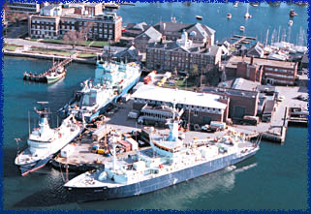


Late 19th century – early 20th century:
Founding a number of important marine laboratories, including coastal labs and open ocean labs.
1888
Founded 1930
Founded 1903

Slide 26
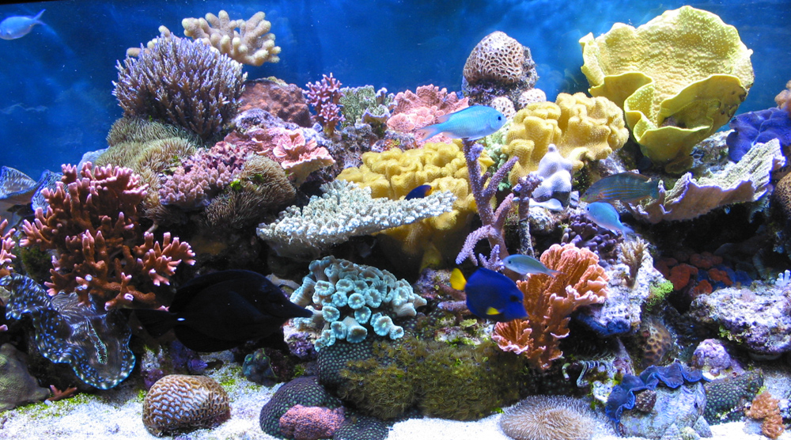
Coral Reefs

Slide 27
Coral Reef
limestone
Coral reefs are __________ islands in the sea that are built by coral animals called polyps.
Thousands of species of plants and animals live in the cracks and crevices of coral reefs, making coral reefs among the most ________ ecosystems on Earth.
Corals can only live in _____ salt water where there is enough ______ for photosynthesis. Therefore, coral reefs are only found in shallow, tropical seas.
diverse
light
warm

Slide 28
Threats to Coral Reefs
If the water surrounding a reef is too hot or cold, or if fresh water drains into the water surrounding a reef, corals have trouble producing limestone.
If the water is too muddy, too polluted, or too high in nutrients, algae that live within the corals will die or grow out of control and smother the corals.
Oil spills, sewage, pesticide, and silt runoff have all been linked to coral reef destruction.

Slide 29
HOW OCEANOGRAPHIC DATA IS COLLECTED

Slide 30
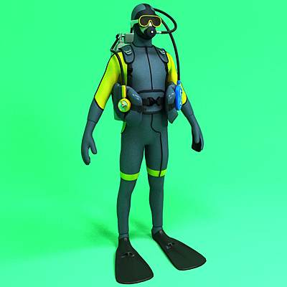
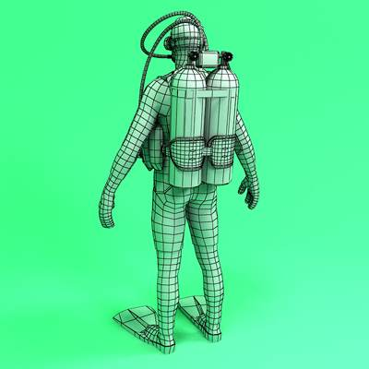
Instruments of Investigation
SCUBA – Self-Contained Underwater Breathing Apparatus. Tanks of compressed air strapped on a diver’s back and connected by hoses to a mouthpiece for breathing

Slide 31
Instruments of Investigation (cont.)
SONAR – Sound Navigation And Radar. Methods of mapping the ocean floor by transmission and reflection of sound waves
Geostationary operational Environmental Satellites (GOES) orbit the Earth at 22,000 miles. They are highly advanced observation platforms supplying detailed imagery of the Earth’s oceans

Slide 32
Instruments of Investigation (cont.)
D. Underwater Laboratories – The Aquarius Underwater Laboratory is the only undersea laboratory dedicated to marine science operating in the world. Aquarius provides life support systems that allow scientists to live and work underwater, in reasonably comfortable living quarters, with sophisticated research capabilities.
Scientists on the Aquarius are often called "Aquanauts" (as they live underwater at depth pressure for a period equal to or greater than 24 continuous hours without returning to the surface).

Slide 33
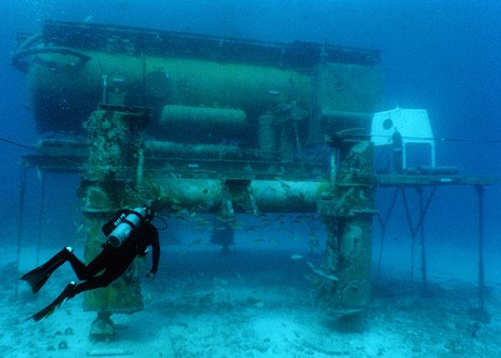
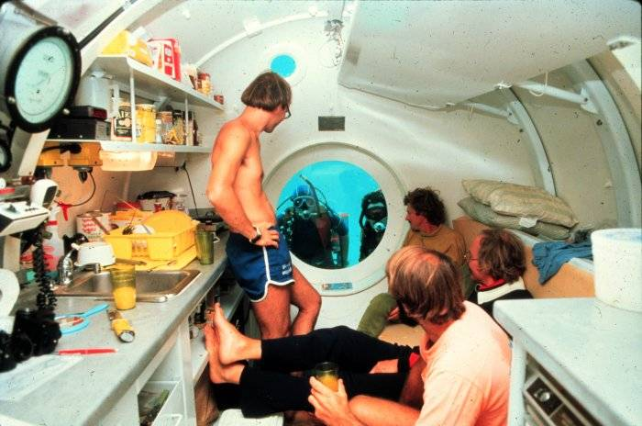

Slide 34
Instruments of Investigation (cont.)
E. Deep ocean submersibles – Over the last few decades, engineers have developed technologies capable of meeting the many challenges that the deep sea imposes upon explorers.

